Slide 1

IoT/B/S/H Device controller
Teodor Barča
Michal Petričko
Richard Palocsányi

Slide 2
Project Goals
Create visually appealing transitions
Implement sensor-based controls
Develop an easy-to-use app
Ensure compatibility with various IoT devices
Enable seamless connections between devices

Slide 3
Key Components
Driver for controlling the LEDs
Mobile app using Python and Kivy/KivyMD
Potential for integration with physical LED devices

Slide 4
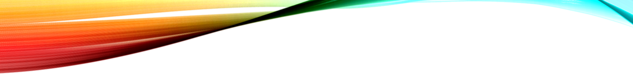
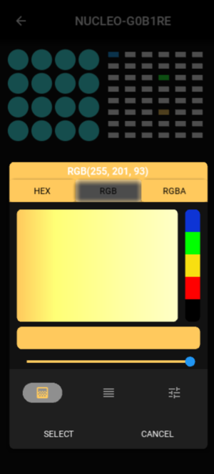
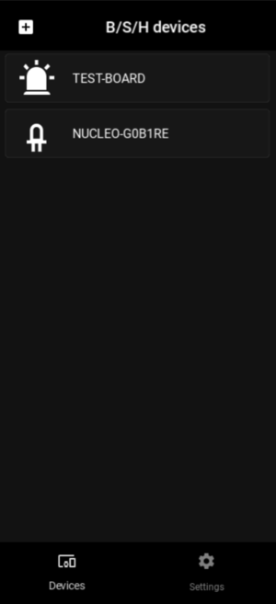
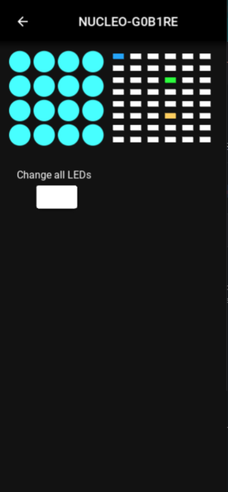

App Showcase

Slide 5
Development Process
Utilize STM32Cube IDE and example bridge program
Rewrite driver for compatibility with target device
Implement FastAPI and Python for bridge and control aspects
Develop mobile app using Python and Kivy
Enable device addition, control, transitions, and other features

Slide 6
Challenges Faced
Difficulties with driver development and communication
Partial success in achieving communication between driver and LED Extension Board
Creation of simple light animations

Slide 7
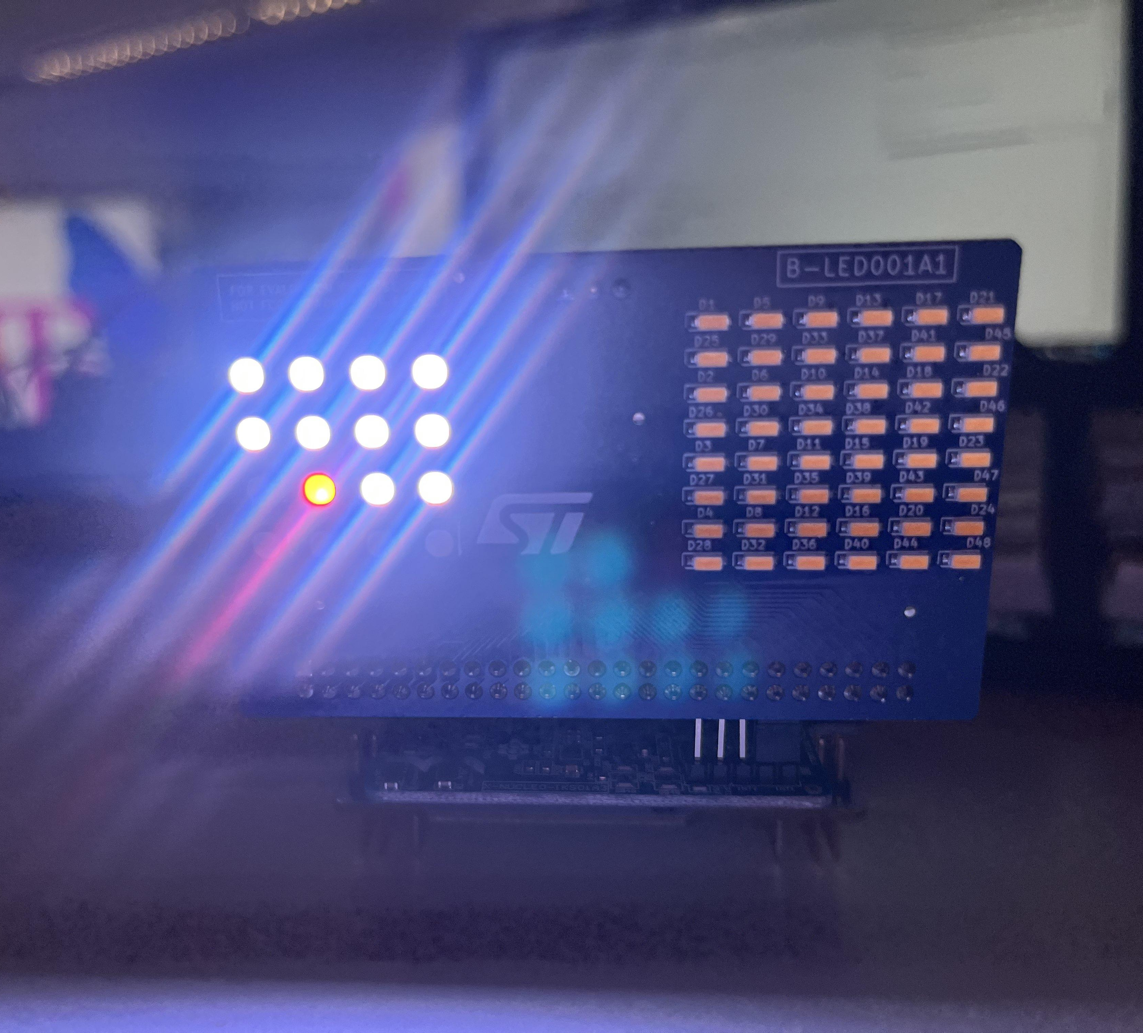
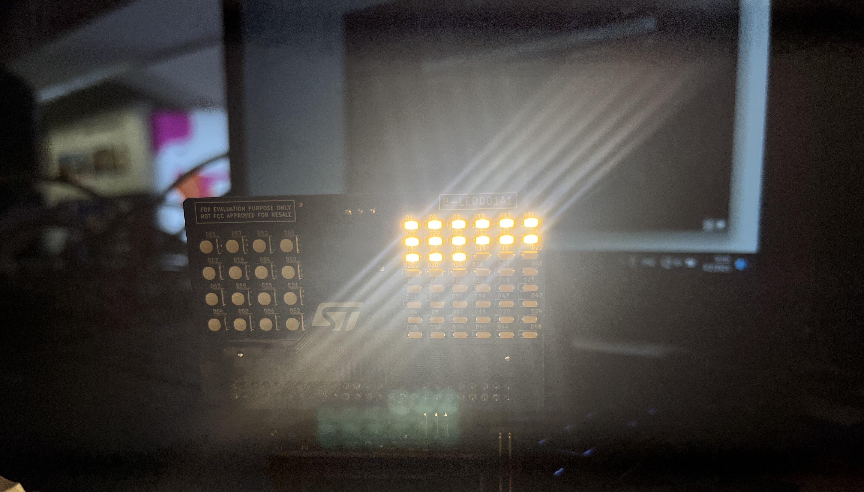
Hardware Integration

Slide 8
Proud Accomplishments
Successful driver-to-LED Extension Board communication
Learning from the challenges of driver development

Slide 9
Lessons Learned
Understanding the complexity of driver development
Gaining valuable experience for future projects

Slide 10
Future Directions for B/S/H Device Controller
Comprehensive mobile app for IoT device management
Advanced tools and functions for device control
Enhanced connectivity and interaction between IoT devices

Slide 11

Thank you for your attention

